Slide 1

Implementation of Smart Home Sensor Networks with Amazon SNS
Group 27: Dhairya Ajitkumar Patel, Krishna Kanth Mutta, Yash Tiwari Electrical and Computer Engineering
Photo credit: @bruce.digital

Slide 2
Table of Contents
Motivation
Literature Review
Gap Analysis and Problem Statement
Approach and Methodology
Experimental Results
Conclusion
Questions And Answers
References

Slide 3
Motivation

Slide 4
Motivation
In order to enable smart living, smart home technology offers a variety of independently and remotely operated software and hardware that are connected to a network.
Smart homes have immense potential to shape the future living, and the market is maturing, but factors influencing households’ adoption of smart home technology services are still an understudied area.
To understand this, in this project we have simulated an environment of Smart Sensor Networks using Omnet++.

Slide 5
Literature review

Slide 6
Literature Review
The monitoring and control of lights, fans, overhead entertainment systems like TVs, and other appliances is no longer the sole focus of modern home automation systems.
Today's home automation systems operate increasingly complex systems including unauthorised entry detection, gas and smoke detection, autonomous irrigation systems, and much more in addition to lighting and fan control [1].
Implementing access control system using RFID could be less secure as the RFID tags / cards can easily be accessed by intruder. A simple camera can be used which scans the person’s face and make the system more secure [2].

Slide 7
Literature Review
Smart home automation can be implemented in many ways [3] such as
Power Line Based
Wired based
Wireless
The complexity of system is reduced to a great extent due to the technologies like Bluetooth, Wi-Fi, Zig-Bee with an advantage to operate the controllers remotely [4]
In this project our focus is using Wi-Fi as a communication medium for the implementation of Smart Home automation System.

Slide 8
Gap analysis and problem statement

Slide 9
Gap Analysis and Problem Statement
The need for a smart home security system with increased efficiency is in increased demand. Here in our project, we have analyzed the traditional models and designed this project in order to achieve –
Real time alerts
Intrusion surveillance
Energy efficiency
The main focus of our project is to generate real time alerts using Amazon SNS during intrusion or bad air quality or inappropriate temperature or smoke detection.
This enhances the living and the safety standards of the homeowners

Slide 10
approach and Methodology

Slide 11
Approach and Methodology
In our project, parameters like type of sensors, communication range, communication protocol used, packets received different sensors, etc are configured in Omnet++ environment.
The project also demonstrates the Python – Amazon SNS setup which continuously reads sensor data from the user/sensor and the user is notified using SNS service when the sensor values are above the threshold point.
In this project we have used 5 types of sensors:
Smoke Sensors (3)
Camera Sensor (1) to detect intrusion
Humidity Sensor (1)
Carbon dioxide Sensor (1) to monitor the level of O2
Temperature Sensor(1)

Slide 12
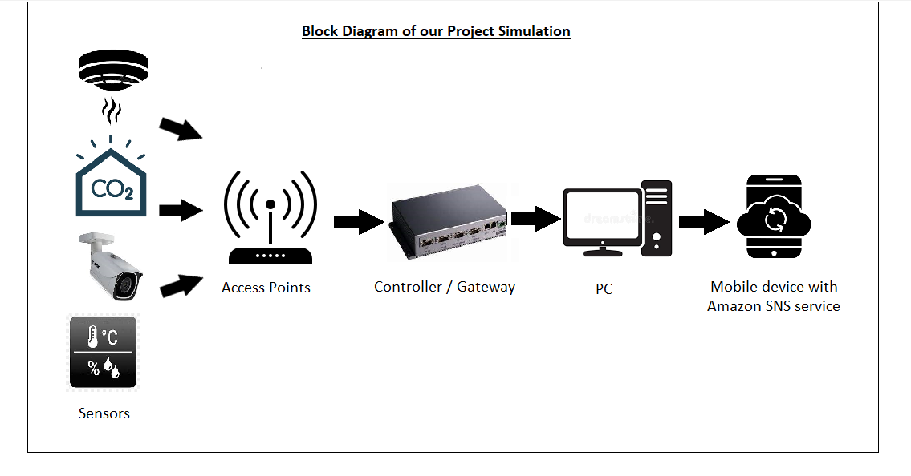
Methodology

Slide 13
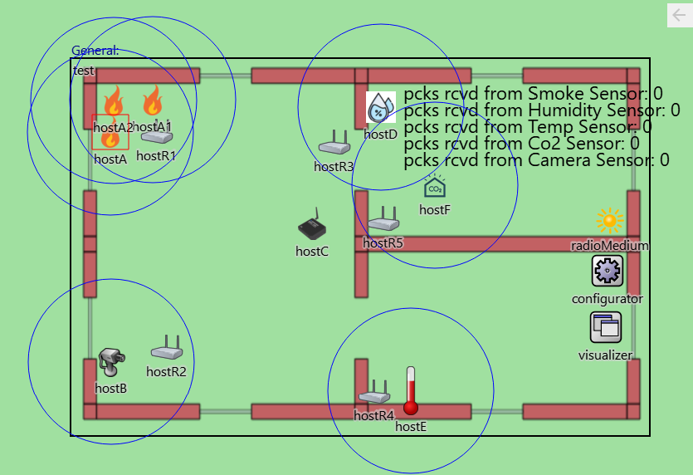
Wireless Network Setup in Omnet++ Environment
Sensors have different transmission rates and packet sizes.
Humidity, Co2, Temperature sensor send each packet @ 15 sec and the size of the packet is 64 bytes.
Camera sensor sends each packet after 20 sec and the size of each packet is 1024 bytes. The smoke sensor is set at 5 sec and the packet size is 64 bytes.
The communication range of each type of sensors is kept at 100 units.
The sensors are kept static over the area of 695 x 454 units

Slide 14
Wireless Network Setup in Omnet++ Environment (contd.)
The transmission rate of the sensors is decided according to the criticality of the type of sensor.
As the communication range of all the sensors is 100 units, they collectively send the packets to their assigned access points which then forward the packet to the controller.
The controller acts as a gateway and it finally can be used to send the data to the local PC.
The communication protocol used in the MAC layer is IEEE802.11, which explains that the communication between nodes is done wirelessly.
Data packet forwarding is kept true so that packets are sent to the controller with hops.

Slide 15
Implementation of Amazon SNS
Implementation of Smart Home Sensor Networks with Amazon SNS

Slide 16
Implementation of Amazon SNS
When triggering events reach the cloud, a text message is sent to the user using the Simple Notification Service from Amazon Web Services (AWS - SNS).
The pub/sub functionality of AWS SNS enables many-to-many messaging between geographically dispersed systems with high throughput and low latency. Users can be notified by emails or SMS for mobile devices.
The command line interface, access key, security password, and location (US-East server was used) had to initially be configured in order to use the AWS SNS mechanism. The python core algorithm logic is then combined with the "boto3" library to publish messages to the cloud and then inform users of occurrences on a pre-specified mobile number.

Slide 17
Experimental Results (Omnet++ Simulation)

Slide 18
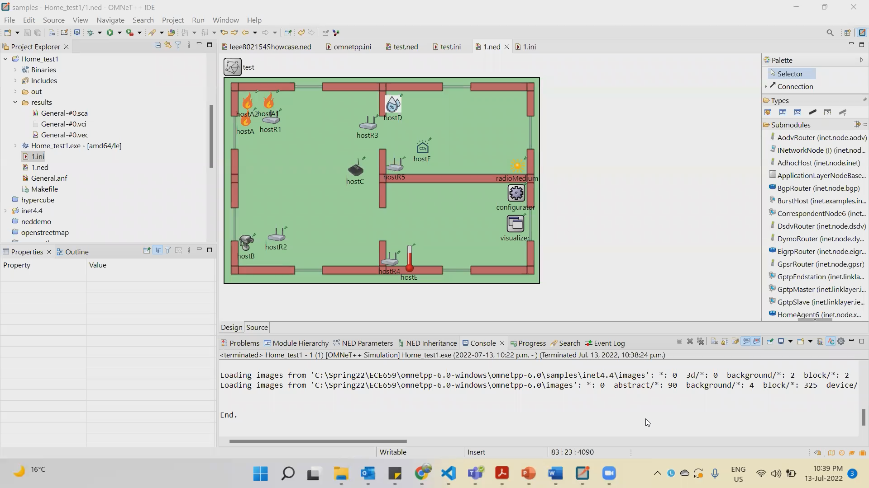
Experimental Results (Omnet++ Simulation)

Slide 19
Experimental Results (Demo of Sensor data on Python with SNS)

Slide 20
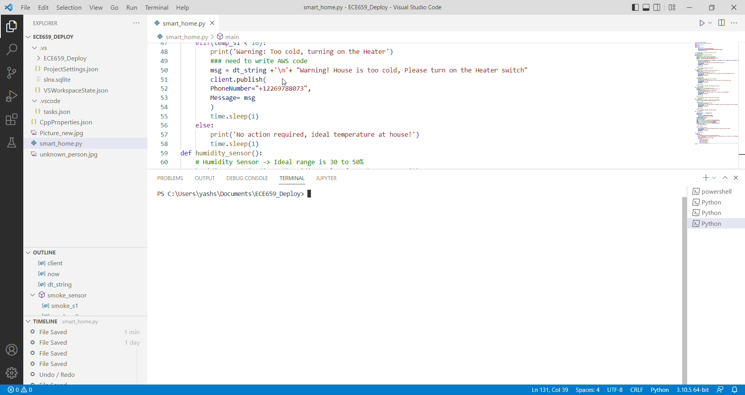
Experimental Results (Demo of Sensor data on Python with SNS)

Slide 21
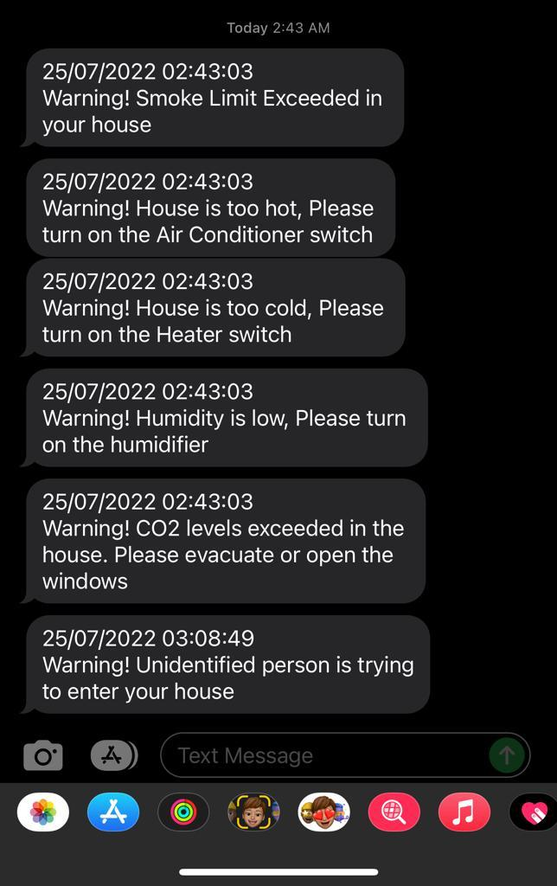
Experimental Results (NOTIFICATIONs ON Mobile device from Amazon SNS)

Slide 22
Conclusion

Slide 23
Conclusion
Thus, using Omnet++, Python and Amazon SNS system we were successfully implement the wireless sensor networks using 5 different type of sensors for Home Automation.
Using Omnet++, we successfully performed the simulation that resembled closely with how real sensors would communicate with the access-points and send control signals to notify the user in case of any abnormality.
The logic of triggering of sensors in case of any abnormality was done using combination of python libraries and the users are notified of the event using Amazon SNS service

Slide 24
Questions and Answers

Slide 25
Questions and Answers
Testing your knowledge:
Why the packet transmission rate for different sensors is kept different?
Why there are 3 smoke sensors, and the remaining sensors are 1 in number?
How the user receives the notification on his mobile device?

Slide 26
Questions and Answers
Answers
As smoke detector is the most critical in any home, to detect the presence of fire, the transmission rate is the highest. This quickly helps in detection and notifying the user through notification service. The remaining sensors are less critical based on their application, so the data rates are kept less as compared to the smoke sensor.
There might be case when the alarm is falsely triggered, this can be due to various reasons. As we don’t want that the person is notified even if there is no fire in the house, we have used three sensors with a logic that if any of the two sensors data values goes above the threshold, only then the notification is sent to the user.
We have incorporated the use of Amazon SNS messaging service with our python code. It simulates and sends the notification when the sensor data reaches threshold value. This service is used as it is very simple and cheap.

Slide 27
References
Patil, Manasee & Reddy, S.. (2013). Design and Implementation of Home/Office Automation System based on Wireless Technologies. International Journal of Computer Applications. 79. 19-22. 10.5120/13745-1504.
V.J, S. (2017, April 7). Home Automation using Arduino and GSM Module. Electronic Circuits and Diagrams-Electronic Projects and Design. https://www.circuitstoday.com/home-automation-using-arduinoand- gsm module
What is home automation system? - Structure, Types. (n.d.-b). ElPro-Cus - Electronic Projects for Engineering Students. Retrieved August 15, 2021, from https://www.elprocus.com/home-automation-systemsapplications/
Structuring and Design of Home Automation System using IOT. (2018). International Journal of Recent Trends in Engineering and Research, 4(5), 200–206. https://doi.org/10.23883/ijrter.2018.4368.gjcfn

Slide 28
Thank You

